Slide 1
Reamer Operation Missed–K0PG SHAFT COMP CAM
DOWEL COMES OUT WHILE NOISE VEHICLES INSPECTION AT CUSTOMER
MAP-ID BLR
REPORTING DATE: 19th Jan-2022

Slide 2

REPORT INDEX
Subject ：- DOWEL COMES OUT WHILE NOISE VEHICLES INSPECTION AT CUSTOMER
■Contents of report-Reamer Operation Missed-K0PG Cam Shaft
 | Contents | page | Cum Time Sec
1 | Overview & Background | 01 | 30
2 | Observation & Process Flow | 01 | 30
3 | Traceability | 01 | 30
4 | Identify Occurrence Root cause | 01 | 30
5 | Identify Outflow Root cause | 01 | 30
6 | Occurrence & Outflow Countermeasure | 02 | 60
7 | Standardization | 01 | 30
8 | Countermeasures Summary (With Management action) | 01 | 60
9 | Horizontal deployment | 01 | 30
 | Total(Q & A) | 10 | 5min 30
Shaft Comp Cam
□ HONDA ACTIVA 6g
Date ： 2021/Dec/10
Reported ： Musashi Auto Parts India Pvt. Ltd
Approval
Check
Issued
Umashankar San
Hishikari / Prashanth San
Ujjal /Abidali

Slide 3
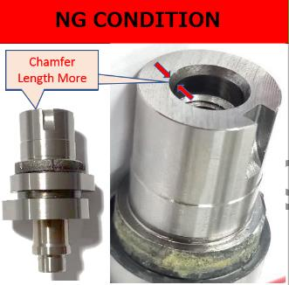
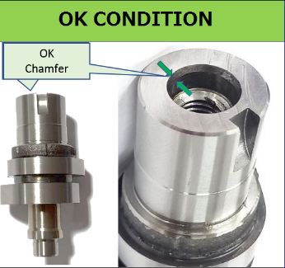
OVERVIEW & BACKGROUND
1. Overview | Parts Name : Shaft comp Cam (K0PG)
1-1. Phenomenon of Occurrence | Reamer Operation Missed
1-2. Number of Claims | 02Nos ⁽Vehicle rolled out)
1-3.Occurance Lot No. | Invoice No. 8212104605
1-4. Cause of Occurrence | Dowel Pin Came Out
1-4. Countermeasure Details | Immediate action: 100% Parts checked Identify Process Verify-Occurrence and Outflow
1-5. Affected Range | 8065Nos
Groove
Groove
Reamer Operation Missed Parts Having Chamfer Length more
Spe:10.00-0.02 /-0.035mm
( Obs: 9.626 & 9.596mm)
Reamer Operation Parts Having Chamfer Length Less Spe: 10.00-0.02 /-0.035mm
( Obs: 9.975mm)
Available Parts Segregation Details- Shaft Comp Cam Operation Missed
Sl. No. | Stage | Qty | OK | NG | Pending
1 | Wear house | 15,300 | 15,300 | 0 | 0
2 | FG | 0 | 0 | 0 | 0
3 | QGATE | 0 | 0 | 0 | 0
4 | ASSY | 288 | 288 | 0 | 0
5 | PROCESS | 7777 | 7777 | 0 | 0
Total |  | 23,365 | 23,365 | 0 | 0
Reference photo for understand Problem.

Slide 4
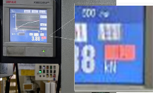
OBSERVATION & PROCESS FLOW
DETAILS OF NG PARTS –AS INFORMATION
PRESENT CONTROL AT MAP-ID
SL No | Verification Items | Rule | Observation On NG Parts | Result
01 | Parts inspection | Parts marking on face after inspection | Available on parts | OK
02 | Dowel Condition | As per drawing | Assy at vehicle there is no any information initially | OK
03 |  | Should not Comes Out | Dowel Pin Comes Out | NG
04 | Initial observation | As per Parameters checked | Cam Shaft ID 10.0 -0.020,0.035 observed up to 9.626 & 9.596 | NG
K0PG LINES
K0PG ASSY LINES
CONTROLS
LINE-3
LINE-2
In load cell identified the Reamer Operation missed parts as NG
LINE-4
LINE-6
LINE-3
LINE-7
Dowel Pin Assy
Interlock Gauge Pass NG
Occurrence – Under Analysis
Outflow-Controls
PROCESS SEQUENCE
Occurrence
Receiving Inspection
Facing & Centering
Turning 1
Turning 2
Drilling reaming
Keyway Milling
Cam Milling
Induction Hardening
ASSEMBLY PROCESS
Big Bearing Assy
Child Parts Assy
Visual Inspection
Cam Lapping
Buffing
Small Hole Drilling Reaming
Cam Grinding
Axis Grinding
Outflow
Small Bearing Assy
Dowel Pin Assy
Final Inspection
Dispatch
As per the Observation There is control at Occurrence and outflow

Slide 5

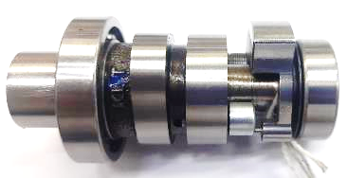
CAM SHAFT K0P LOT TRACEABILITY - REAMER OPERATION MISSED
Summary -Observation
1.Supected Batch Dispatch From M/S MAP-ID to M/S MAP-ID GUJRAT On 27.11.2021 on A shift.
2.Supected Defect parts lot Nos 1.10812570 ,10443050 & 10443002 .
3.Total Qty of the Batches 10812570-9811,10443050-2278 10443002-825Nos
4. 4.Defect Parts Made between 23th Nov "C" shift to 26th Nov "C" Shift
5.There is observed one changepoint as per the log book records
(Checking the points of change)
Robo Drilling
Change point found in Robo Drilling M/C (Tapp Rigid Alarm at Line-6) 2021.11.26 C-shift M/C interrupted.
Line-6
xxxxxxxx | Suspected lot Dispatches in the invoice
xxxxxxxx | Defect Parts Flow Lot No.in the Invoice
xxxxxxxx | Not Dispatch in the Invoice.

Slide 6
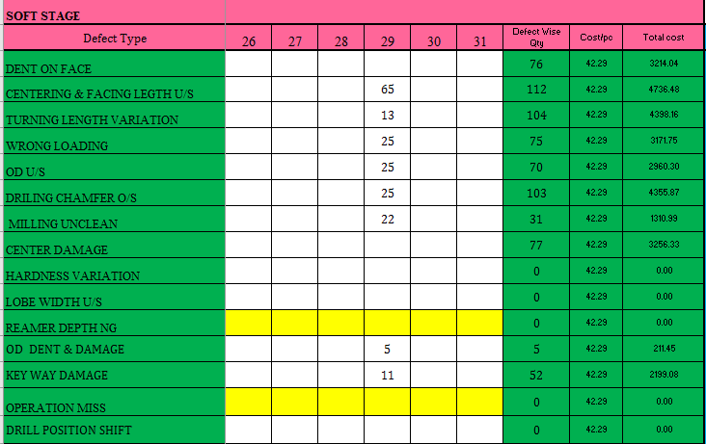
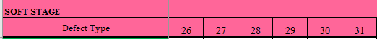
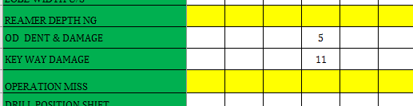
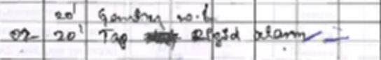
OCCURANCE ANALYSIS
CHANGE POINT RECORD
4M | PARAMETERS | CHECKING METHOD | ACTUAL | STATUS
M (Man) | Skilled Operator at critical stations Skill of inspector at Q check gate | - Attendance records - Manpower fixation sheet - Skill matrix - Judgement skills | No Change | ○
M ( Machine ) | Change in Machine Change in machine program Major breakdown /maintenance Wear parts condition | -Maintenance records -All Poke-yoke implementation & controls of machine -Change point control/ Log book | With reference to logbook, there is tap rigid alarm in line 6 | X
M (Method ) | - As per PQCS As per work instruction As per rules | -PQCS revision -Work instructions -Rule root/procedure Vs Actual (By check sheet/record) | NG Parts Outflow to Next Process | X
M (Material ) | As per PQCS Change in Sub supplier | -PQCS -Approved sub supplier list | No Change | ○
Logbook Sheet
Rejection Logbook Sheet
In line 6 Logbook Record there is change point in Machine Alarm on the day

Slide 7
IDENTIFY OCCURRENCE ROOT CAUSE
Reamer Missed Factor Analysis
Sl No | Possible causes | Rule | Actual | Status
1 | Tool condition | No breakage | No Damage | O
2 | Power failure | Follow Power Failure handling Rules | No Power Failure | O
3 | Machine Interruption | Cutting has to be done as per the program sequence | Incomplete cutting sequence ( Rigid tap alarm) | X
4 | Inspection Frequency | 1/50 measuring frequency | Frequency followed | O
5 | Alarm Parts Handling | Treat as abnormal part | Treated as normal part | X
6 | Setup Change | No mix up of abnormal part | No mix up (No setup change) | O
REAMER MISSED WHY WHY ANALYSIS
Step | Why1 | Why2 | Why3 | Why4 | Why5
Occurrence | Cutting sequence as per program one tool missed | Tap rigid alarm | Excess load on spindle during tap | Clamped Part slipped due to Clamping jaws worn out | Premature failure of Jaws
 | Treated as normal part | By Visual check took decision | Self Judgment taken with Visual Inspection (OK Method: Plug Gauge) | Misjudged as Alarm was regarding Tapping and thread was present and OK in the part | Less awareness on the judgement procedure after alarm

Slide 8
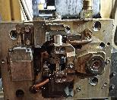
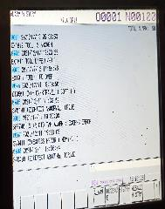
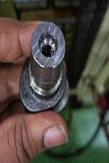
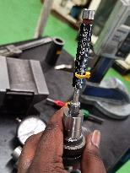
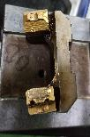
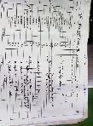
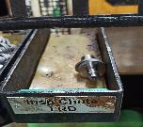

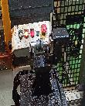
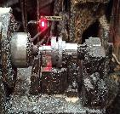
OCCURRENCE & OUTFLOW MECHANISM
Overall process
Customer simulation Information
Facing and centering
Drilling
Turning 1
Turning 2
Tapping
Occurrence & Outflow
Change Point
Simulation Part
Occurrence
Part clamping condition
Drilling,tapping,reaming
Keyway milling
Reaming
Cam milling
Thread operation completed part
Reamer not ok dimensions 9.625mm (specification 9.965mm-9.980mm) operation checking
Induction hardening
In robo drill machine tap rigid alarm coming
Clamping jaw face line mark coming in jaws face
Axis grinding
Conclusion:-Since the simulation, the cause of the reamer operation miss is parts tilled due to less gripper
Cam grinding
Scrap Not Highlight no evidence on Scrap
Small hole drilling reaming
Change Point
Outflow
Parts handling
Buffing
In logbook two part rejected in robo drill operation
Cam lapping
After alarm part coming in inspection chute
Inspect by manually
Next operation no detection reamer operation
Load the part by manually
Visual inspection
Conclusion-Outflow to next process
Conclusion:- Based on the simulation cause of the reamer operation miss due to part slippage issue. After tap change no alarm found.

Slide 9
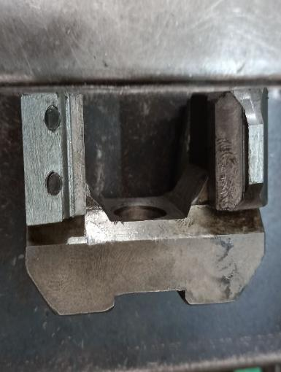
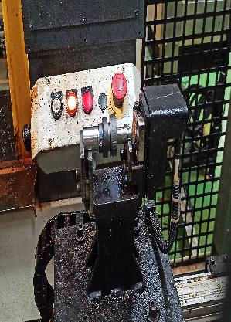
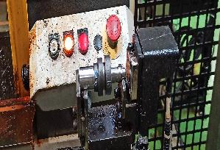
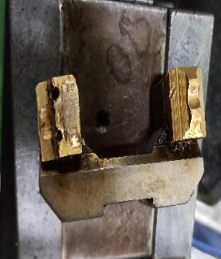
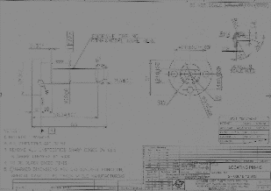
OCCURRENCE COUNTERMEASURE-PROCESS
Occurrence
Outflow
Before
After
Before
After-Proposal
Jaw Gripper Under
process
Jaw Gripper Under
process
Pin Type Sensor mounting to identify Operation
Φ9.9
Brass clamping pad.
New Metal Clamping.
POKA YOKE Drawing
Life established: 1,00,000 pices.
Obs: 82,000
Life established: monitoring is started.
Feasibility is under discussion with machine maker
Conclusion:- 1.Clamping pad changed for better clamping & detection pokayoke Feasibility under discussion with machine maker.

Slide 10
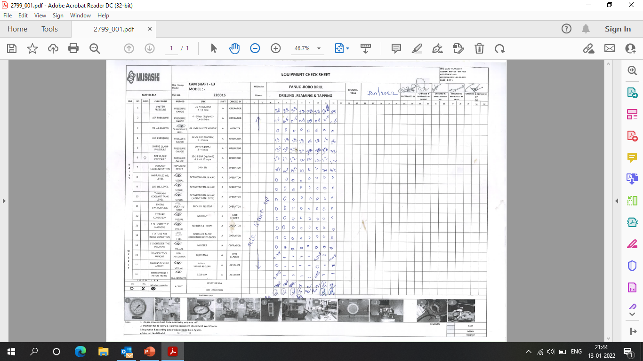
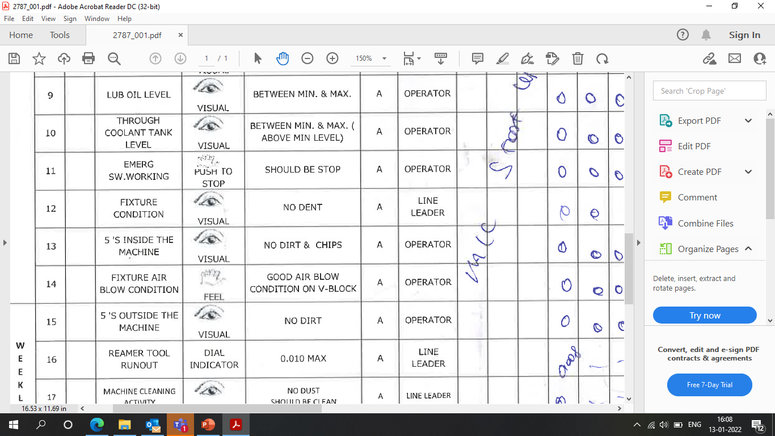
TPM CHECK SHEET ( Evidence requested by customer )
Fixture condition Visual inspection check point available in TPM.

Slide 11
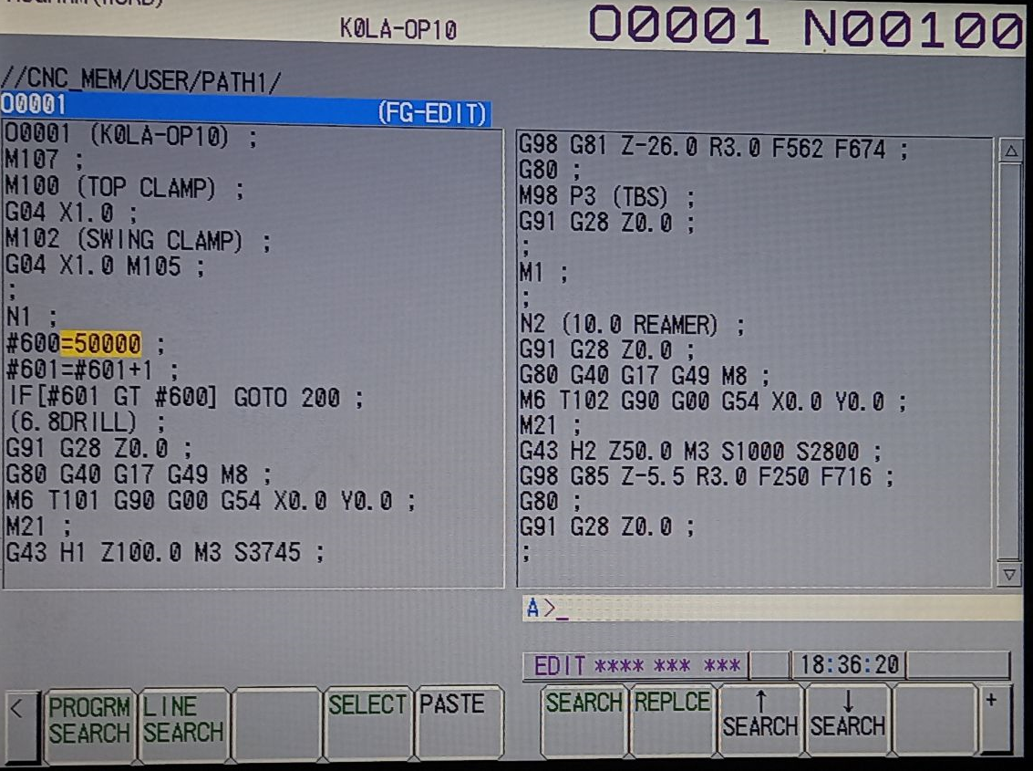
FIXTURE LIFE CONTROL ( Evidence requested by customer )
Macro program is crated for life monitoring.

Slide 12
ANALYSIS-4M OUTFLOW
CHANGE POINT RECORD
4M | PARAMETERS | CHECKING METHOD | ACTUAL | STATUS
M (Man) | Skilled Operator at critical stations Skill of inspector at Q check gate | - Attendance records - Manpower fixation sheet - Skill matrix - Judgement skills | No Change | ○
M ( Machine ) | Change in Machine Change in machine program Major breakdown /maintenance Wear parts condition | -Maintenance records -All Poke-yoke implementation & controls of machine -Change point control/ Log book | No Change | ○
M (Method ) | - As per PQCS As per work instruction As per rules | -PQCS revision -Work instructions -Rule root/procedure Vs Actual (By check sheet/record) | NG Parts Outflow to Next Process | x
M (Material ) | As per PQCS Change in Sub supplier | -PQCS -Approved sub supplier list | No Change | ○
As per The Logbook Record there is a change point in 26.11.2021 C-shift M/C got interrupted

Slide 13
IDENTIFY OUTFLOW ROOT CAUSE
Factor analysis :
Sl No | Possible causes | Rule | Actual | Status
1 | Load Cell Working Condition | No abnormal | No abnormal | O
2 | Operator Skill | Skill level2 (Individual can Operate) | Person is Skilled(Level-2) | O
3. | Alarm (NG) Parts Handling | Followed as per NG part Handling rule with QTAR | Followed with QTAR, but couldn’t capture the Reamer miss part | X
4. | Gauge Detection | Gauge detect as NG | Gauge detected as NG | O
Outflow Why Why :
Step | Why1 | Why2 | Why3 | Why4 | Why5
Occurrence | Alarm part handling Followed with QTAR, but couldn’t capture the Reamer miss part | Part found OK as per existing alarm part handling procedure | In Alarm part handling, Once finding OK after Hand press check and Dowel pin height check, part will be passed | Reamer miss possibility not addressed in alarm parts sorting Procedure | With the Confidence of Existing controls and No past trouble history.

Slide 14
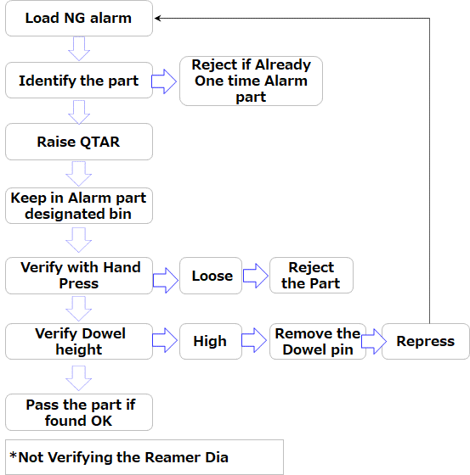
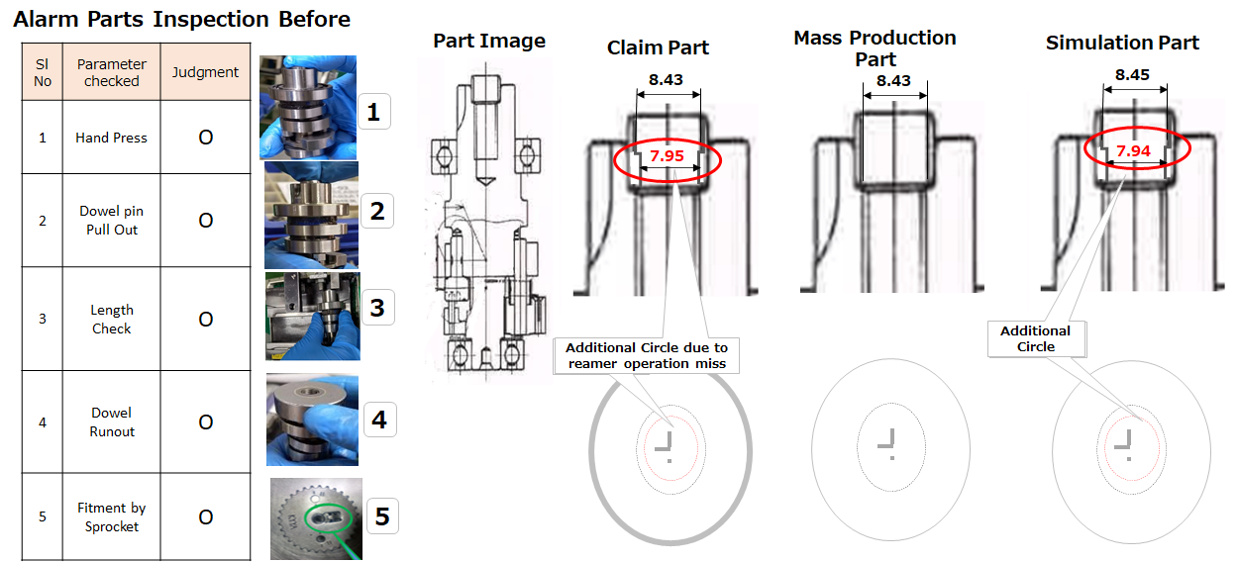
OUTFLOW MECHANISM
ALARM PARTS HANDLING FLOW
OUT FLOW MECHANISM WITH SIMULATION
While Our Inspection of alarm parts Not Consider reamer inside diameter of reamer operation miss parts outflow

Slide 15
OUTFLOW ACTION
BEFORE
AFTER
Load NG alarm
Load NG alarm
Reject if Already One time Alarm part
Identify the part
Identify the part
Raise QTAR
Dowel pin remove and Part Condition Check
Raise QTAR
Keep in Alarm part designated bin
Reverification without removing
Keep in Alarm part designated bin
Remove the Dowel pin
Verify Reamer Dia and Height
Reject if NG
Verify with Hand Press
Loose
Reject the Part
Repress
Reject if Re Alarm
Verify Dowel height
High
Remove the Dowel pin
Repress
Pass the part if found OK
Pass the part if found OK
Re Inspection of Parameters without removing the dowel pin
Procedure Modify to remove the dowel pin directly and to inspect reaming parameters before re press

Slide 16
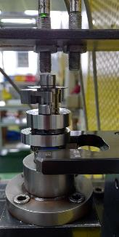
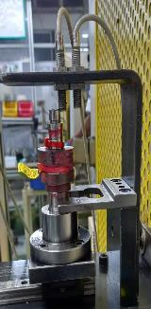
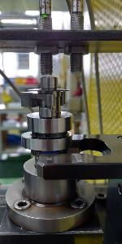
OUTFLOW COUNTERMEASURE
Axis Dia Inspection
Big Bearing Pressing
Small Bearing Pressing
Dowel Pin Pressing
Dowel Pin Pressing
Axis Diameters inspection Gauge
Before-Parts Confirmation
After-Parts Confirmation
OK
NG-
Reamer Opt Missed
Interlock With M/C
OK & NG
+0.01
20
+0.01
21
Ø 9.6-0.10
Ø 9.8-0.10
Locator
Snap Gauge
Snap Gause
Locator Pin has modified to detect the NG Parts(Operation Missed)
Both Parts Same in the gauge-No Detection
Reamer operation Parts not Qualify in Gauge and machine not start.
Detection of reamer Operation missed POKA YOKE Initiated, effectiveness and under monitoring

Slide 17
OCCURRENCE & OUTFLOW COUNTERMEASURE WITH MANAGEMENT ACTION
 | Root Cause | Activity | In Charge | Target Date | Status
O C C U R A N C E | Premature Failure of Jaws | Life to be Re Established by considering premature failure. 2.Clamping pad is changed from brass to steel. 3.Knurling to be Provided for Existing jaws and same to be standardized in Drawing 4. Alarm resetting procedure readdressed for effectiveness. 5 Feasibility to check for POKA YOKA at Manual Loading table for next process. 6.Reamer dia 100% check before assy for one month period for effectiveness confirmation. | Praveen /Abidali Abidali Abidali Abidali Abidali/Ratheesh San Abidali | 12.01.2022 12.01.2022 14.02.2022 20.12.2021 20.01.2022 On going | O O ∆ O ∆ ∆
O U T F L O W | Less awareness on the judgement procedure after alarm No Past Experience. | Standard procedure modified for alarm Judgement parts Alarm Parts treat as Rejection and put red tag and keep in red bin awareness given to all associate line for the issue. Awareness Given to all associate for the Issue. Rework for the Dowel Alarm parts started as defined QTAR Rule. SOP Made for the Alarm handling Parts. POKA YOKE to be implement to detect while Grinding OD Check | Abidali Abidali Seema Seema Seema Seema | 13.01.2022 17.12.2021 18.12.2021 16.12.2021 20.12.2021 20.12.2021 | O O O O O O

Slide 18
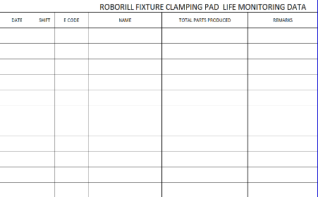
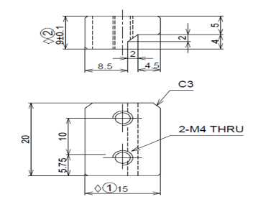
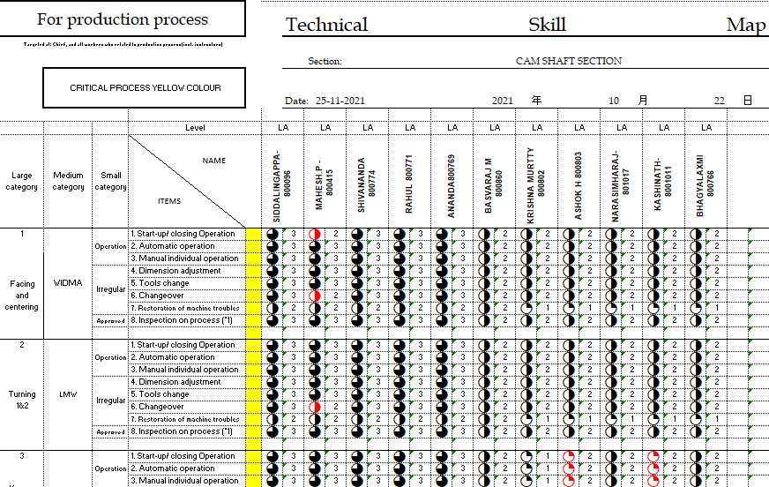
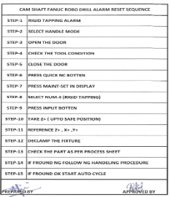
Standardization
OCCURRENCE
Now life monitoring is started for premature of Jaws.
Jaw Drg Before
Jaw Drg After
OJT
Life Tracking Sheet for Jaws
Brass clamping pad
Steel clamping pad
Alarm Re-Setting Process
Skill Matrix

Slide 19
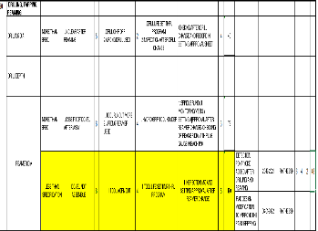
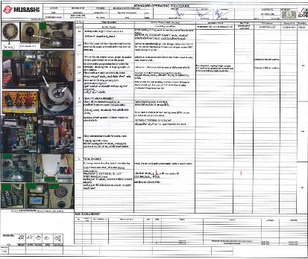
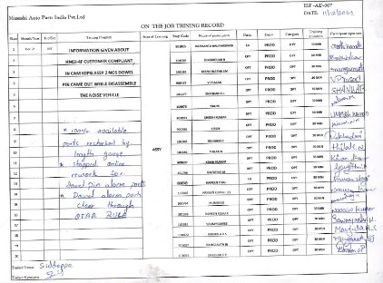
Standardization
OUTFLOW
Updated FMEA
Judgment Procedure
SOP
Before
After
Operator check alarm
Operator check alarm
Correct the alarm
Raise the line siren
Check Parts
Line leader Correct The alarm
Flow to next process by manual loading
Take decision
OJT
In case ok part move the next operation or part NG found follow the NG process

Slide 20
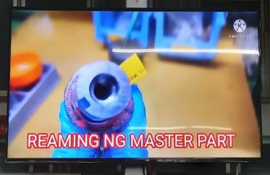
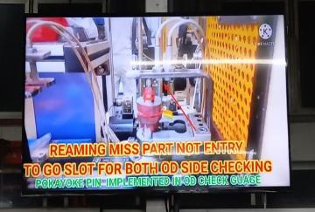
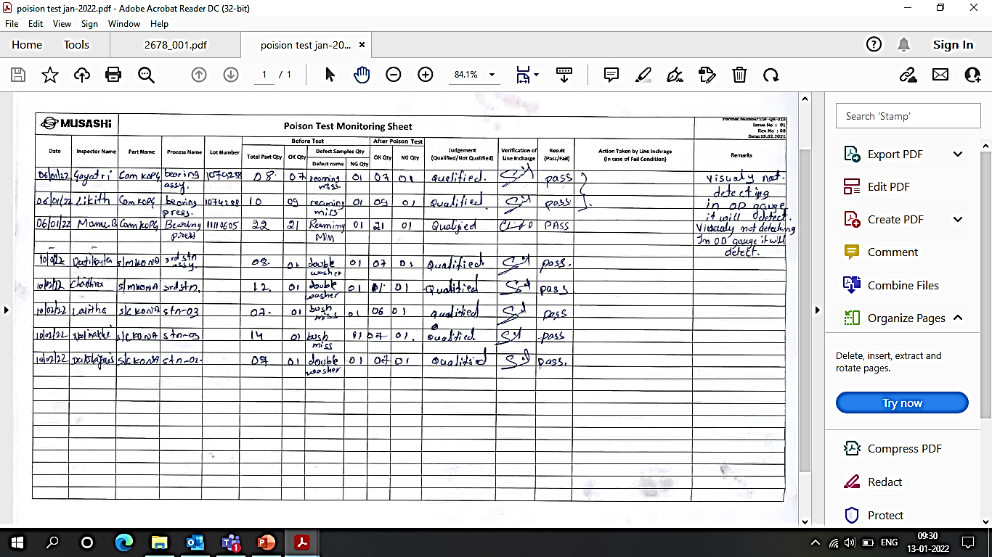
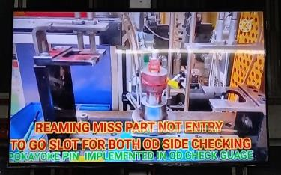
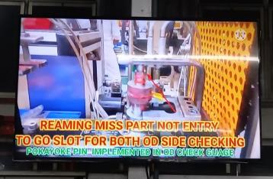
GEMBA EDUCATION & IZIWARU TEST
TV DISPLAY AT ASSY
IZIWARU TEST –ASSOCIATE WISE
Process miss & poka-yoke by video education at gemba & Assy area IZIWARU test conducted.

Slide 21
HORIZONTAL DEPLOYMENT & MANAGEMENT ACTION
Areas | Countermeasure Horizontal Deployment | Line to be Implement
 |  | Assy Line-2 | Assy K0NA | Assy K1CA | Line-1 K0NA | Line-2 K0NA | Line-3 K0PG | Line-4 K0PG | Line-5 K1CA | Line-7 K0PG
Occurrence | Life to be Fixed for Clamping pad. | NA | NA | NA | O | O | O | O | O | O
 | Clamp jaws face Knurling to more grip on Part. | NA | NA | NA | NA | NA | O | O | O | O
 | POKA YOKA to be implement at Manual Loading table for next process. | NA | NA | NA | O | O | O | O | NA | O
 | Operator press siren button when received alarm in machine. | NA | NA | NA | O | O | O | O | O | O
Outflow | Standard procedure made for judgment on alarm parts | O | O | O | O | O | O | O | O | O
 | Alarm Parts treat as Rejection and put red tag and keep in red bin awareness given to all associate line for the issue. | O | O | O | O | O | O | O | O | O
 | Awareness Given to all associate for the Issue. | O | O | O | O | O | O | O | O | O
 | Rework for the Dowel Alarm parts started as defined QTAR Rule. | O | O | O
 | SOP Made for the Alarm handling Parts. | O | O | O
 | POKA YOKE to be implement to detect while Grinding OD Check | O | O | O
1
2
3
4
1
2
3
4
5
6
Actions are initiated and horizontally deployment and will complete within this Month.

Slide 22

THANKS

